Slide 1
Application of Machine Learning in Asset Pricing

Slide 2
Agenda
Short Summary of Results
Overview Machine Learning Methods
Comparison of Results
Why do the Results differ?

Slide 3
1. Short Summary of Results
Compare how well Methods forecast Risk Premia
12 Methods:
Regression Models (add more benchmarks or something)
Decision Trees (mentin asset risk premia)
Neural Networks (mention model somewhere, and excmeples for regressors)

Slide 4
1. Short Summary of Results
Forecast Asset Risk Premia
Model with:
Firm Characteristics
Macroecnomic Factors
…

Slide 9
1. Short Summary of Results
R-Squared Out-Of-Sample
Diebold-Mariano (DM) Test

Slide 10
2. Overview Machine Learning Methods

Slide 11
2. Overview Machine Learning Methods
OLS
OLS-3
Elastic Net
Regression with Shrinkage and Variable Omission

Slide 12
2. Overview Machine Learning Methods
Principal Component Regression (PCR)
Partial Least Squares (PLS)
Both use k Principal Components (PCs)
PCR extracts PCs according to Variance in Regressors
PLS extracts PCs according to Variance in Regressand

Slide 13
2. Overview Machine Learning Methods
Random forest (RF)
Gradient Boosted Regression Trees (GBRT)

Slide 14
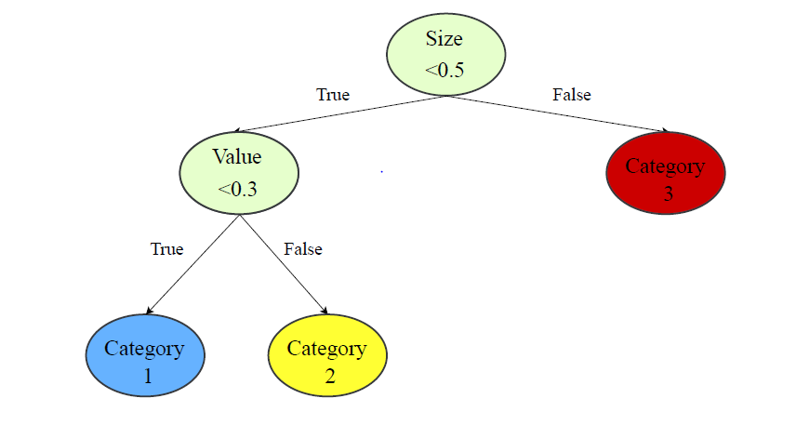
2. Overview Machine Learning Methods

Slide 15
2. Overview Machine Learning Methods
Random forest (RF)
Uses Bagging
Gradient Boosted Regression Trees (GBRT)
Uses Boosting
Notes:
Bagging random sample, and randomly restricts its trees in their choice of variables to split among in every node

Slide 16
2. Overview Machine Learning Methods
Neural Network (NN) (vllt die folie raus?)

Slide 17
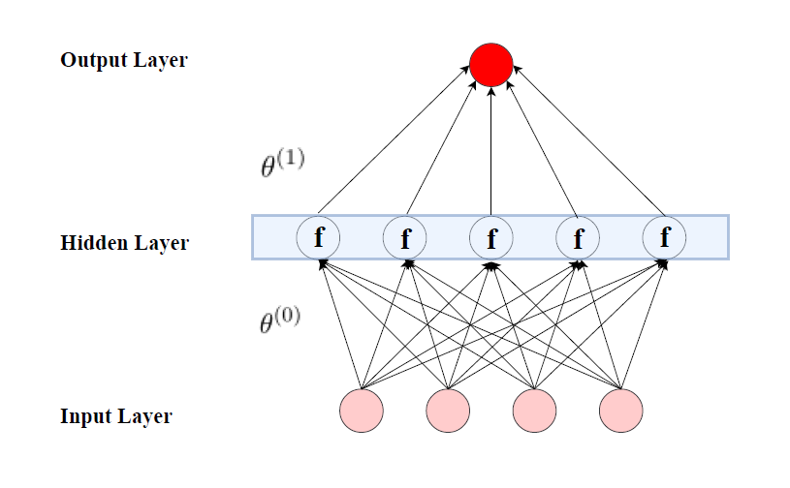
2. Overview Machine Learning Methods

Slide 18
2. Overview Machine Learning Methods
Neural Network (NN)
5 NNs with Hidden Layer Sizes from 1 to 5
Each NN is Ensemble of 10

Slide 19
3. Comparison of Results

Slide 21
3. Comparison of Results
DM Test Results:
Gu et al.: only large differences are significant
My Results: almost all differences are significant

Slide 22
4. Why do the Results differ?
Sample Size
Tuning
Volatility
Notes:
Mention rolling window here

Slide 23
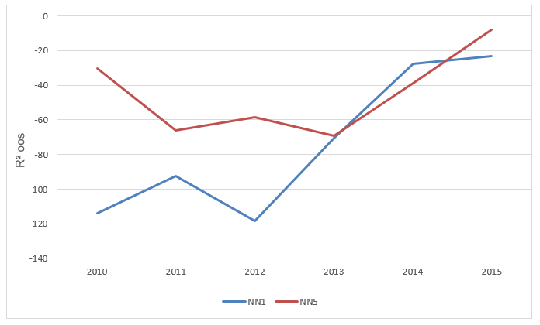

Slide 24
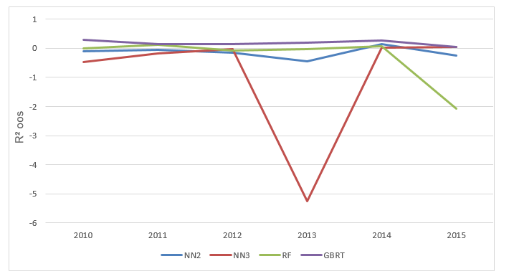

Slide 25
4. Why do the Results differ?
Sample Size
Tuning
Volatility
Notes:
Mention rolling window here

Slide 26
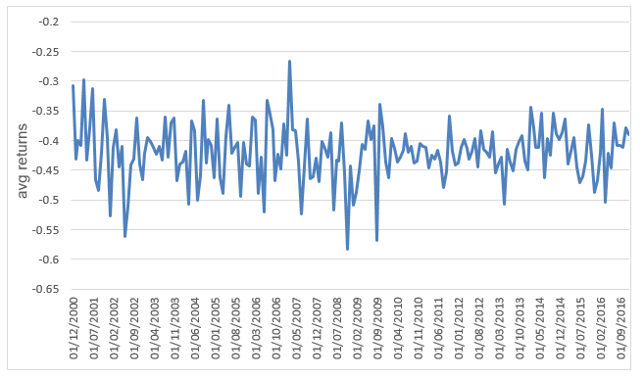

Slide 27
Application of Machine Learning in Asset Pricing

